Slide 1
Data acquisition by Smartphone
Ekansh Gupta L. S. Vishnu Sai Rao

Slide 2
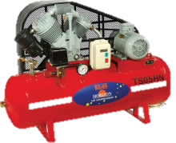
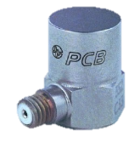
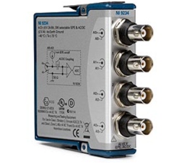
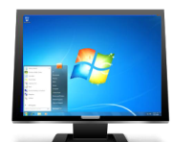
What we already have
Air compressor
Sensor
Data Acquisition Hardware
Desktop
Wired or wireless connection between hardware and desktop

Slide 3


What we want
Air compressor
Sensor
Data Acquisition Hardware
Desktop
Tablet / Smartphone
The connection between desktop and Smartphone shall be wireless

Slide 4
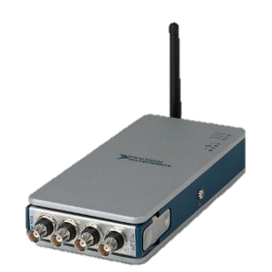

So the effective plan is:
Air compressor
Sensor
Data Acquisition Hardware
Desktop
Tablet/Smartphone

Slide 5

Possible Options: Method 1- Remote Desktop
Web services allow remote connection to any other device, if smartphone/tab having app top view remote screen we can capture data.
Limitations
Support to only windows mobile device
Requires third party softwares i.e. VNC, RDP, Team Viewer, LogMein
Therefore, this was not implemented
Tablet / Smartphone
Desktop
Remote Connection

Slide 6
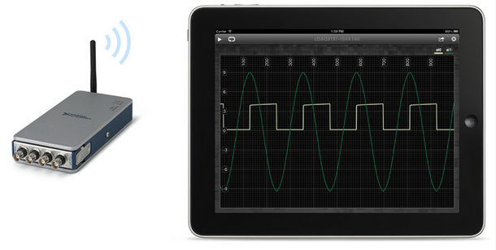
Method 2- Direct Interface to Smartphone
Data Acquisition device can directly send data to mobile device using customized app.
To support mobile devices, wireless data acquisition device need a firmware upgrade.
The cDaq 9191 chassis requires a firmware upgrade for this method which is not yet released. So, this method is also rejected.

Slide 7
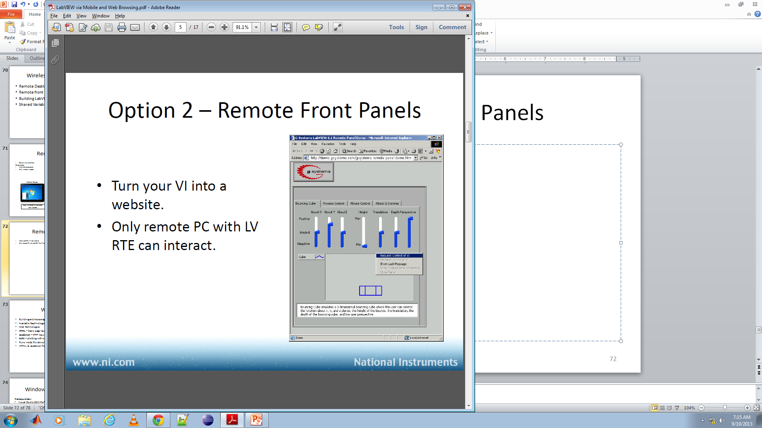
Method 3- Using Shared Variables
Tablet / Smartphone
Desktop
LabVIEW can deploy a shared variable containing the information received from the hardware over a network.
The Smartphone can then connect to the network and plot the variable using an app called Data Dashboard.
This method was used owing to its negligible limitations
Shared variable deployed

Slide 8
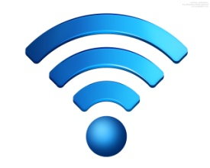
What we did:
Air compressor
Sensor
Data Acquisition Hardware
Wireless Network
Tablet / Smartphone
Wireless Network
Desktop

Slide 9
Step by Step:
The hardware is first made to connect to the laptop wirelessly.
The laptop receives the data and LabVIEW deploys the data packing it into a shared variable.
The Data Dashboard app on the Smartphone is made to connect to the network and so, it is able to access the shared variable.
For the whole process, an external wireless network (ssid was “iitk”) was used in each of these steps. That is, the chassis was configured to broadcast its data on “iitk”. The laptop was also connected to “iitk” and was able to get the data sent by the chassis. LabVIEW then deployed the shared variable again onto “iitk” to which the Smartphone was already connected. The Data Dashboard app on the smartphone was then able to plot the shared variable.

Slide 10
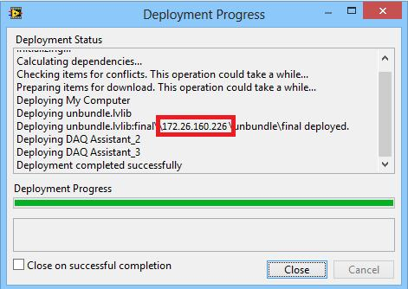
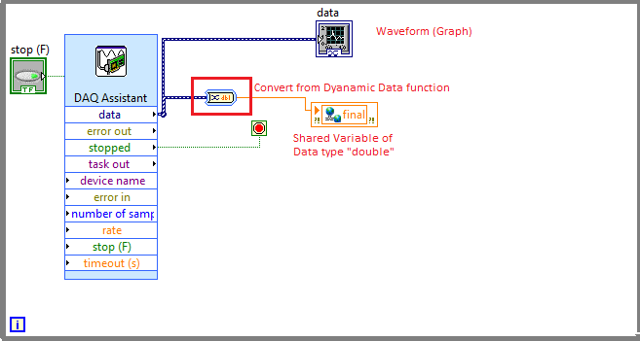
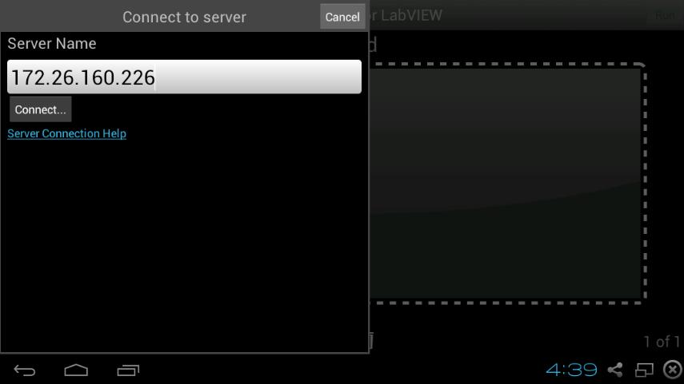
Involved phases
A Virtual Instrument(VI) is made
to extract the data from the chassis
and pack it into a shared variable
2. The variable gets deployed
and the address in red is noted.
3. The Data Dashboard app on smartphone is opened and this address is entered. The app connects to this network and plots the variable in real time.

Slide 11
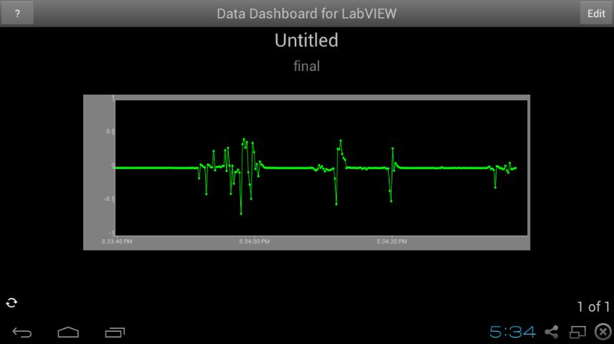
Results
This was plotted on the smartphone in real time using a microphone

